Slide 1
2022 Miracle Economic Recovery
News By Gary Yu

Slide 2
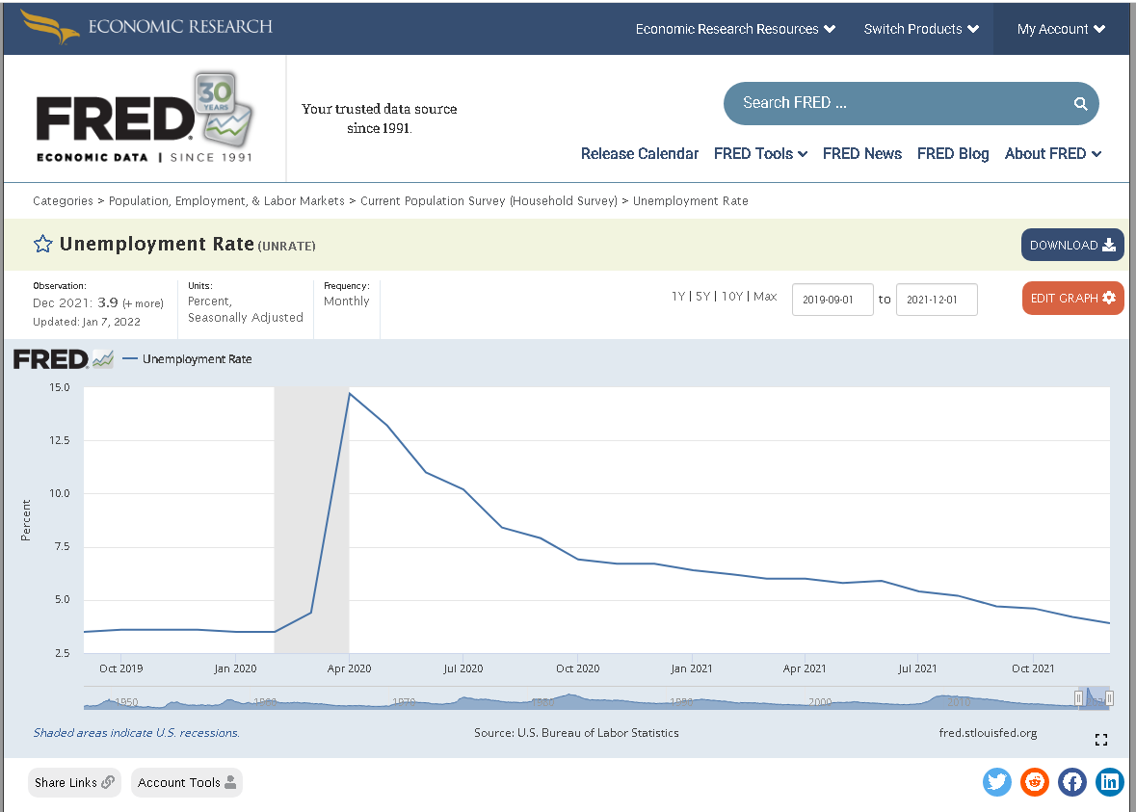
(Unemployment rate)

Slide 3
The News
So, something interesting just happened in these couple of months. The unemployment has gone down from 15% to 3.9% as of December 2021 according to the FRED. (Unemployment rate)
Why this is interesting is because we just went from a great recession to near if not full employment in a year; which is short since the US averages a .55% decrease in unemployment per year (Yoe The consistency of economic recoveries over the 1949–2019 period : Monthly labor review)
The cause of this in my opinion must be due to a casual chain that started with the vaccines/Operation Warp Speed(Office Operation warp speed: Accelerated covid-19 vaccine development status and efforts to address manufacturing challenges), the various stimulus bills(Yoe The consistency of economic recoveries over the 1949–2019 period : Monthly labor review), FED action(low interest rates) (Federal funds effective rate), and even events like increasing home prices leading baby boomers to retire sooner which opened spots for the younger generations. (Fry The pace of Boomer retirements has accelerated in the past year)

Slide 4
MLA 9 Citations
“Unemployment Rate.” FRED, 7 Jan. 2022, https://fred.stlouisfed.org/series/UNRATE.
Yoe, Jonathan. “The Consistency of Economic Recoveries over the 1949–2019 Period : Monthly Labor Review.” U.S. Bureau of Labor Statistics, U.S. Bureau of Labor Statistics, 1 July 2020, https://www.bls.gov/opub/mlr/2020/beyond-bls/the-consistency-of-economic-recoveries-over-the-1949-2019-period.htm.
Office, U.S. Government Accountability. “Operation Warp Speed: Accelerated Covid-19 Vaccine Development Status and Efforts to Address Manufacturing Challenges.” Operation Warp Speed: Accelerated COVID-19 Vaccine Development Status and Efforts to Address Manufacturing Challenges | U.S. GAO, https://www.gao.gov/products/gao-21-319.
Yoe, Jonathan. “The Consistency of Economic Recoveries over the 1949–2019 Period : Monthly Labor Review.” U.S. Bureau of Labor Statistics, U.S. Bureau of Labor Statistics, 1 July 2020, https://www.bls.gov/opub/mlr/2020/beyond-bls/the-consistency-of-economic-recoveries-over-the-1949-2019-period.htm.
“Federal Funds Effective Rate.” FRED, 3 Jan. 2022, https://fred.stlouisfed.org/series/FEDFUNDS.
Fry, Richard. “The Pace of Boomer Retirements Has Accelerated in the Past Year.” Pew Research Center, Pew Research Center, 10 Nov. 2020, https://www.pewresearch.org/fact-tank/2020/11/09/the-pace-of-boomer-retirements-has-accelerated-in-the-past-year/.

